Slide 1
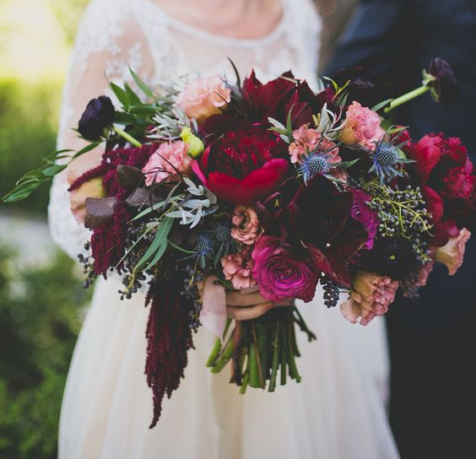
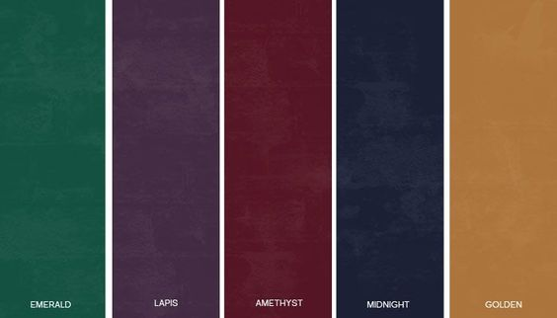
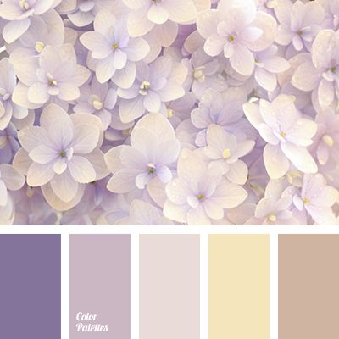
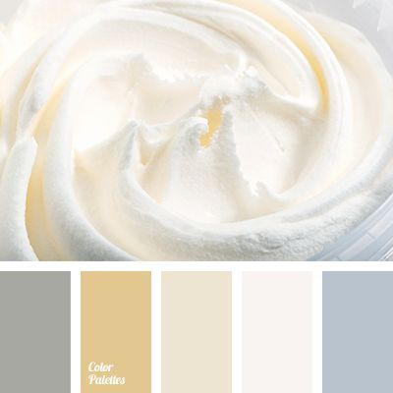
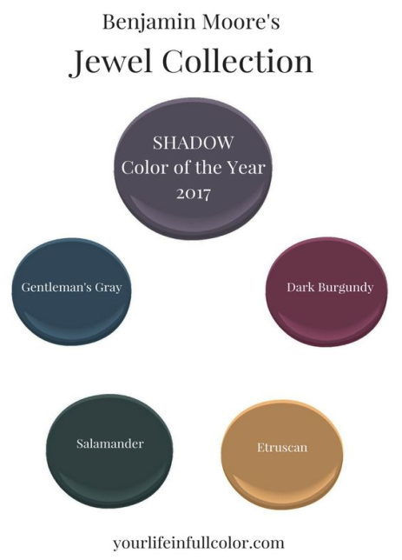
Color Palette
more "masculine" and "natural" colors: terracotta (a bright earthy orange), various shades of ochre (brownish yellow), malachite (dark green), and blue in the hues of lapis lazuli and other striking colors.

Slide 2
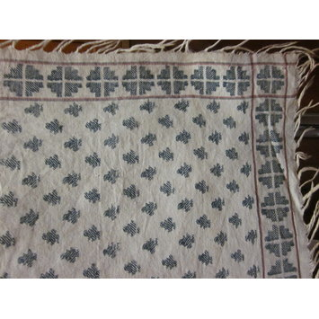
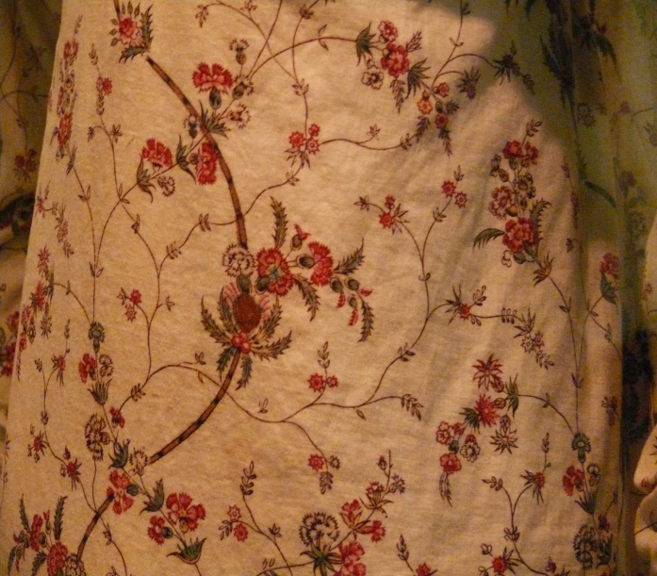
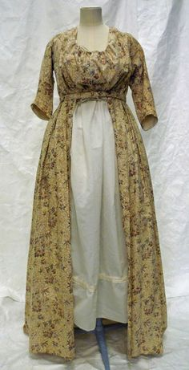
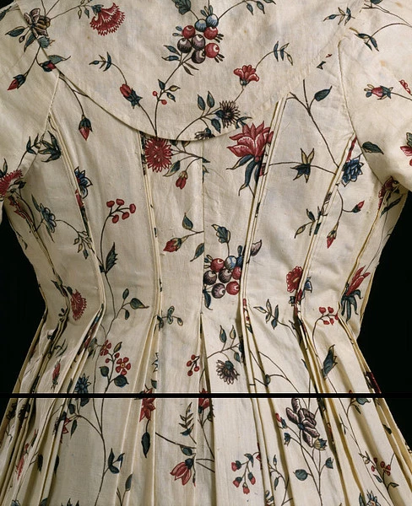
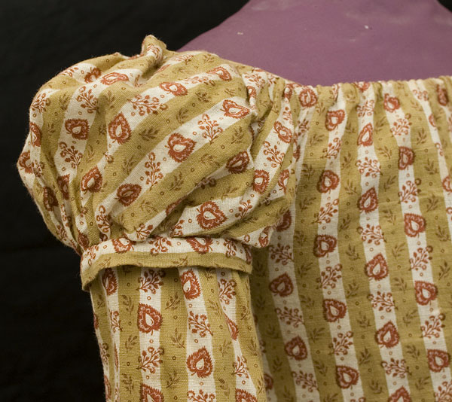
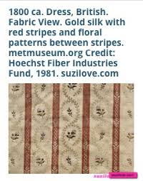
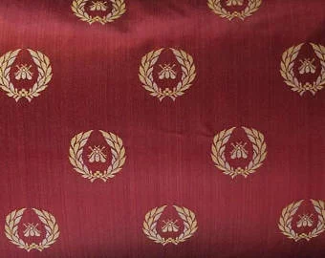
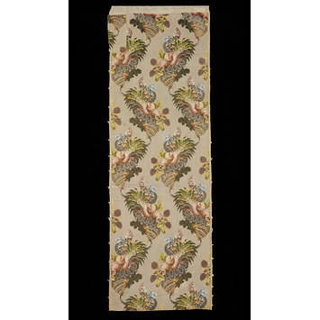
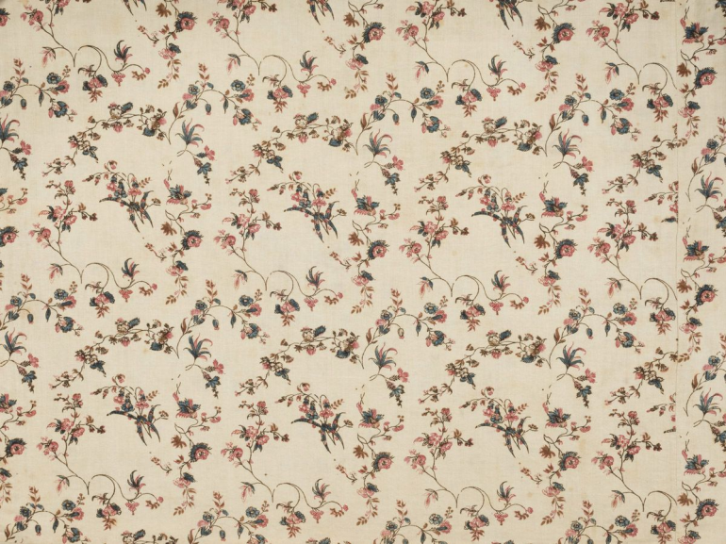
Textiles

Slide 3
History Color/Fabric Notes
Initially, lightweight–sometimes relatively sheer–white fabrics prevailed for the new fashion. The once colorful Greco-Roman statues had been bleached white from exposure to the elements. The imitators of the late 18th/early 19th century interpreted this fact to mean that all of the clothing was also white, thus the choice of white for the neo-classical dresses. Eventually, pastel dresses became fashionable as well.
Merveilleuses were also reported to favor pale pink tights (as if their legs were blushing from being exposed)
Beginning with the French Revolution, male attire becomes more and more sedate–devoid of qualities now considered acceptable only in feminine attire (ie. bright and bold colors, lace, embroidery, excess of decoration, etc.). Lavish fabrics lose favor to practical ones.
The gentleman’s cravat is pristinely white and well pressed.
Shirts were made of cotton or linen and were cut full through the chest
The most common neckwear item was still the cravat. These were long rectangular strips of cloth (60″x10″ on average) that were wound around the neck over the tall collar of the shirt. Starched muslin or taffeta were commonly used–Black and White being the most common.
TEXTILES: Fabrics are simpler and less decorative on the whole, particularly at the beginning of the period. Ladies dresses favor cottons and linens. Men’s suits favor wool. Silks will return to ladies’ dresses in the second half of the period.

